Slide 1
An Interface between Quantum Physics and Human Consciousness can be found in the Sensory Level of the mind
Ian Thompson with the Theistic Science Group:
Gard Perry, Ron Horvath, Andy Heilman, Steve Smith, Reuben Bell and Forrest Dristy
Version 5

Slide 2
Outline
Here are two problems presently unsolved in science:
Quantum measurement problem
How we quickly recognize external objects
Show some materialist or mechanical proposals trying solving these problems
How should we understand all this from the Writings?
The sensory mind and the brain are distinct discrete degrees.
Sensory mind acts as a Quantum-like Epistemic Engine (QLEE):
Use joint quantum measurements affecting the brain and the QLEE together.
Its quantum probabilities can represent sensory credences.
Proposed new interface between mental and physical degrees:
Fast object recognition via Asymmetric joint measurement events

Slide 3
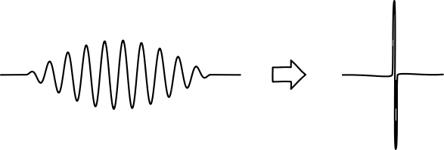
Quantum measurement problem
Contrast between classical and quantum waves:
Classical waves (e.g. air or ocean) affect everywhere where that wave is
Quantum waves (e.g. electrons or light) affect only one place in where that wave is.
Why?
Problem also known as:
“Reduction of the wave packet”
“Selection of actual outcome”
”Reducing a superposition of alternatives to only one actually occurring”

Slide 4
Materialist Proposals to solve the Quantum Measurement Problem
Trying to make quantum physics a bit more classical:
Is there a quantum limit to one of these properties?
Maximum distance within superposition (Einstein in 1930s)
Maximum energy difference (Maxwell)
Maximum gravitational energy difference (Penrose)
Maximum complexity (Weingarten)
Some new spontaneous mechanism (Ghirardi, Rimini, Weber)
More details in chapter 12 of my book “Philosophy of Nature and Quantum Reality”, http://www.generativescience.org/books/pnb/pnb.html
But very difficult to find any limit experimentally: nothing found yet!
Notes:
Any

Slide 5
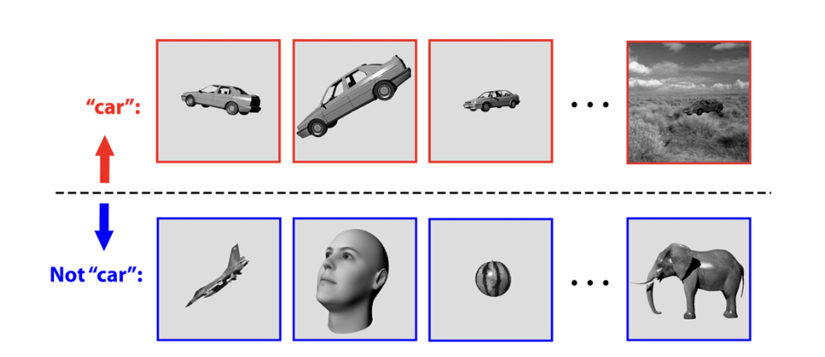
Sensory object-recognition problem
Humans and animals quickly recognize visible objects
Do this despite varying distance, rotation, lighting, movement, etc.
Do this within 1/10 second: only ~ 100 neural steps possible.
This is done in the
sensory mind.
How?
Figure from Rudrauf et al, J.Theo.Bio. 428 (2017) 106

Slide 6
Mechanical Proposals to solve the Sensory Recognition Problem
This a problem in cognitive psychology. They want to propose a mechanism to do object recognition.
Two kinds of proposals:
Bottom-up: Progressing extraction of abstract properties, such as edges > lines > boundary curves > 3D objects.
Top-Down: quickly adjusting the parameters of a predictive mechanism until it agrees with the input from the senses.
Both of these kinds require a very much ‘neural computation’.
There might be enough neurons in brain, but getting to coordinate quickly enough is very difficult.

Slide 7
Principles from the Writings
The mental and physical are distinct discrete degrees
Connected by influx from mental to physical,
which generates correspondences.
Correspondences are patterns of similar functions.
Correspondences facilitate repeated influx in all the parts
Sensory mind and visual cortex are closely connected.
We should expect many correspondences between them

Slide 8
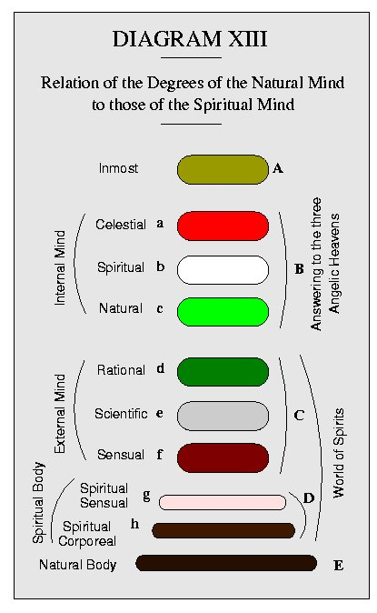
Place of the sensory mind.
There is a whole cascade of discrete degrees though the spiritual and natural worlds.
All of them have their own roles in preparing for actual results in the physical.
Sensory awareness is the very outmost mental degree of the external mind (f here).
Picture from N.C. Burnham’s book “Discrete Degrees”, 1887.
theisticscience.org/books/burnham/index.htm

Slide 9
Similarities of ideal solutions to 2 problems: for Quantum selections in green, sensory selections in blue.
Should select among many alternatives ‘already there’.
Photon or electron exposes one photographic grain in whole film.
Sensory shape could be one of very many objects recognizable
Should select alternatives in configuration spaces with very large numbers of dimensions
Entangled particles require 3 dimensions for each particle.
Recognizable objects appear in very many possible transformations
Should be very fast, so outcome ‘pops into existence’
The selection of one photographic grain collapses whole state, and quicky produces (e.g.) just one exposed grain in a film.
Our sensory mind can rapidly recognize objects.
Especially dangerous objects!

Slide 10
These are corresponding functions
Many corresponding features of quantum and sensory observation events.
Both are ‘observations’ in a sense.
But Quantum events are random but Sensory events are determined
Maybe: both result from an influx event
Joint event: both physical and epistemic (recognizing) effects
Interface between two discrete degrees: how influx works

Slide 11
Sensory mind as a QLEE: Quantum-like Epistemic Engine
Use correspondences to design a sensory mind with some features of an analog quantum computer:
Initial quantum state has stored correlations about objects in the world and their possible appearances
Further production of possible spatial translations, rotations (etc) as affects our seeing
First joint measurement on QLEE determined by the sensory input.
Second interior measurement on QLEE gives credences for the objects seen

Slide 12
This might work, but is too slow by Standard Quantum Mechanics
Normal quantum mechanics:
when there are very many possible outcomes, they selected randomly.
The first measurement would need to be repeated many times until it gives a view agreeing with senses.
This slow speed is caused by the Probability Gap.

Slide 13
From the Writings
The outmost degree is terminating and fixed.
Makes a foundation for higher discrete degrees.
Not itself conscious.
The outer degrees are physical degrees.
Suggests:
This outermost physical is the location of definite quantum selections as effects or uses.
The outermost physical in some way contains or constrains the outermost mental (the sensory mind).

Slide 14
Speed up by using constraints from the outermost physical degree
From the Writings, since quantum measurements still mostly a mystery:
Specific joint measurement events exist with QLEE and the brain.
Joint Probabilities of outcomes determined only by outermost degree.
Senses constrain sensations!
Not by both sides as in normal quantum theory.
Now: an Outer degree contains and constrains the next Inner degree.
New physics: call them Asymmetric Joint Measurement Events.
This asymmetry is why I call it a quantum-like epistemic engine.
Quick transmission of sensory information to the Epistemic Engine
So sensory recognizing is not (much) random.

Slide 15
Summary
View the sensory mind as a Quantum-like Epistemic Engine
A kind of analog quantum computer
Uses probabilities to represent epistemic credences.
Uses entangled quantum states to store connections between objects in the mind and possible sensory views.
Neurons in the brain in joint quantum measurements with GLEE
Asymmetric measurements mean sensory inputs select specific associations in the sensory minds.
Hence very fast selection of the observed objects that caused the view actually seen.
Better understanding of the interface between discrete degrees.

Slide 16
Conscious Object Recognition by Quantum Selection
External
World
Physical
world
Mental
World
QLEE
Inner
mind
Eyes
Possible
objects
Actual
view
Mental
light
possible
Current
objects
(short
term
memory)
views
Narrow range
of views allowed by eye input
Visual
cortex
Superposition of reflected light
from all possible + current objects.
Actual view selects recognized object:

Slide 17
THE END

Slide 18
‘Consciousness’ in the Writings
What is ‘consciousness’ in the Writings?
The manner in which love and wisdom operate together: DWis 6, 7.
Personal consciousness only arises after birth when lungs-and-heart operate together like love-and-wisdom.
The power to do anything, or create something
is love in conjunction with wisdom: that power of creating.
Not ‘awareness’ or ‘consciousness’ by itself

Slide 19
Alongside our earlier theory
Postscript
How spiritual influx shows itself in physics by means of modifying some of the ‘constant’ parameters in physics (like charge or electric permittivity).
See New Philosophy, Vol 121, pp 284-294 (2020)

Slide 20
Role of God here
God operates everywhere throughout the physical universe.
God is not in time and not in space.
God is present non-temporally and non-spatially.
God is able to ‘see’ both super-position and collapse of the wave function
As God can be present to physical substance without violating God’s own laws of order.
This occurs whether or not a human being is present to observe it.

