Slide 1
Getting Quantum Measurements to do something Useful in Cognitive Psychology
Design of a
Quantum-Like Epistemic Engine for Fast Object Observations
Ian J. Thompson
Nuclear Data and Theory Group
Lawrence Livermore National Laboratory
This work was performed under the auspices of the U.S. Department of Energy by Lawrence Livermore National Laboratory under Contract DE-AC52-07NA27344.

Slide 2
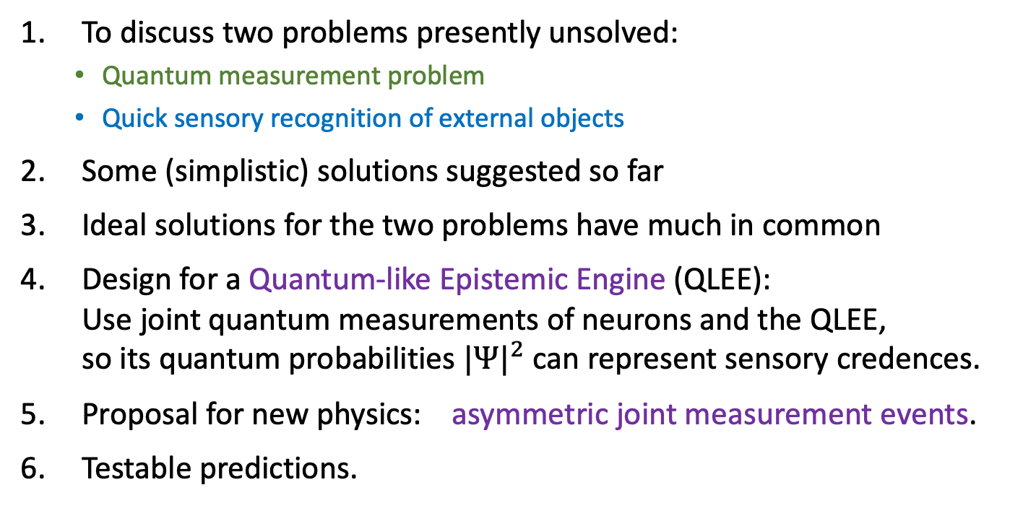
Outline
To discuss two problems presently unsolved:
  Quantum measurement problem
  Quick sensory recognition of external objects
Some (simplistic) solutions suggested so far
Ideal solutions for the two problems have much in common
Design for a Quantum-like Epistemic Engine (QLEE):
Use joint quantum measurements of neurons and the QLEE,
so its quantum probabilities ${|Ψ|}^{2}$ can represent sensory credences.
Proposal for new physics: asymmetric joint measurement events.
Testable predictions.
Notes:
:the

Slide 3
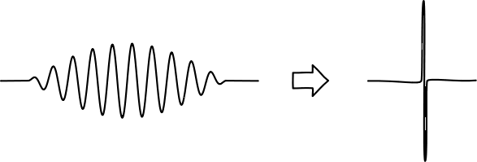
Quantum Measurement Problem
Contrast between classical and quantum waves:
  Classical waves (e.g. air or ocean) have effects everywhere where wave is
  Quantum waves (e.g. electrons or light) have effects in only one place within range where that wave is.
Why?
Problem also known as:
  “Reduction of the wave packet”
  “Selection of actual outcome”
  ”Reducing a superposition of alternatives to only one actually occurring”

Slide 4
Classical Solutions Proposed
Trying to make quantum physics a bit more classical:
Is there a quantum limit to one of these properties?
Maximum distance within superposition (Einstein in 1930s)
Maximum energy difference (Maxwell)
Maximum gravitational energy difference (Penrose)
Maximum complexity (Weingarten)
Some new spontaneous mechanism (Ghirardi, Rimini, Weber)
More details in chapter 12 of my book “Philosophy of Nature and Quantum Reality”,
http://www.generativescience.org/books/pnb/pnb.html
But very difficult to detect any limit experimentally: nothing found yet!
Notes:
Any

Slide 5
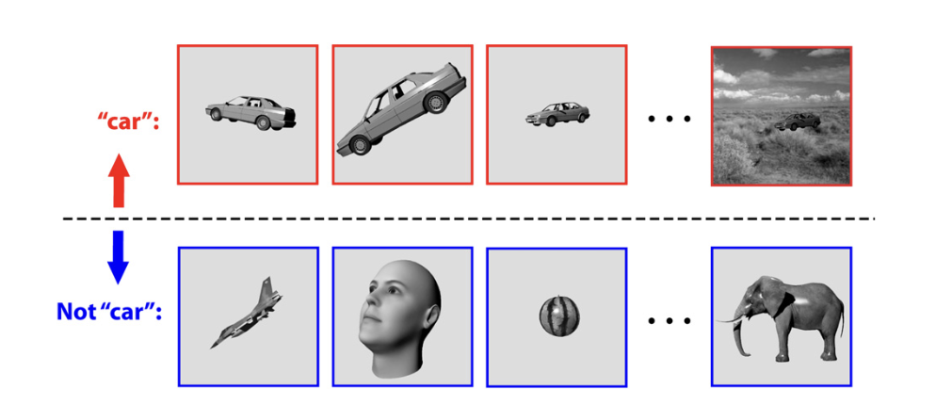
Sensory Object-Recognition Problem
Humans and animals quickly recognize visible objects
  Do this despite varying distance, rotation, lighting, movement, etc.
  Do this within 1/10 second: only ~ 100 neural steps possible.
This is done in the
sensory mind.
How?
Figure from Rudrauf et al, J.Theo.Bio. 428 (2017) 106

Slide 6
Mechanical Solutions Proposed
This is a problem in sensory / cognitive psychology.
Two kinds of proposals:
  Progressing extraction of abstract properties, such as edges > lines > boundary curves > 3D objects. (bottom-up)
  Getting proposed scenes from a predictive mechanism, and then quickly adjusting its inputs until agrees with view. (top-down)
Both of these kinds require lots of ‘neural computation’.
  There might be enough neurons in the brain,
  but difficult to get them to coordinate quickly enough.

Slide 7
Similarities (or not) of the two kinds of Observations?
Many common features of ideal solutions of quantum and sensory observation events.
Maybe: both aspects of a new kind of event?
  Joint event with both physical and epistemic effects
  Both are observations
But there is a Probability Gap:
  Quantum events are random but sensory events deterministic (mostly)

Slide 8
Similarities of ideal solutions: for Quantum selections in green, sensory selections in blue.
Should select among many alternatives ‘already there’.
  Photon or electron exposes one photographic grain in whole film.
  Sensory shape could be one of very many objects recognizable
Should select alternatives in configuration spaces with very large numbers of dimensions
  Entangled particles require 3 dimensions for each particle.
  Recognizable objects appear in very many possible transformations
Should be very fast, so outcome ‘pops into existence’
  The selection of one photographic grain collapses whole state, and quicky produces (e.g.) just one exposed grain in a film.
  Our sensory mind can rapidly recognize objects.
    Especially dangerous objects!

Slide 9
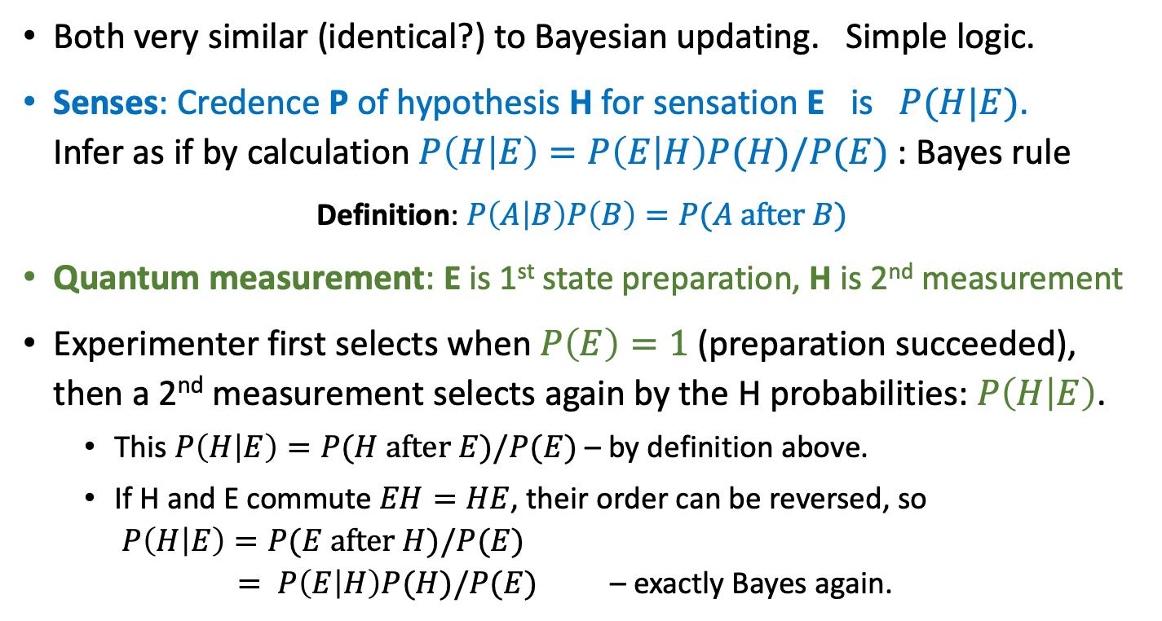
Bayes in quantum and sensory steps
Both very similar (identical?) to Bayesian updating. Simple logic.
Senses: Credence P of hypothesis H for sensation E is $P(H|E)$.
Infer as if by calculation $P\left(H | E\right)=P\left(E | H\right)P(H)/P(E)$ : Bayes rule
Definition: $P\left(A | B\right)P\left(B\right)=P(A after B)$
Quantum measurement: E is 1st state preparation, H is 2nd measurement
Experimenter first selects when $P\left(E\right)=1$ (preparation succeeded),
then a 2nd measurement selects again by the H probabilities: $P\left(H | E\right)$.
  This $P\left(H | E\right)=P(H after E)/P(E)$ – by definition above.
  If H and E commute $EH=HE$, their order can be reversed, so
  $P\left(H | E\right)=P(E after H)/P(E)$
  $= P\left(E | H\right)P(H)/P(E)$ – exactly Bayes again.
See Earman(2020)
Busemeyer (2009)

Slide 10
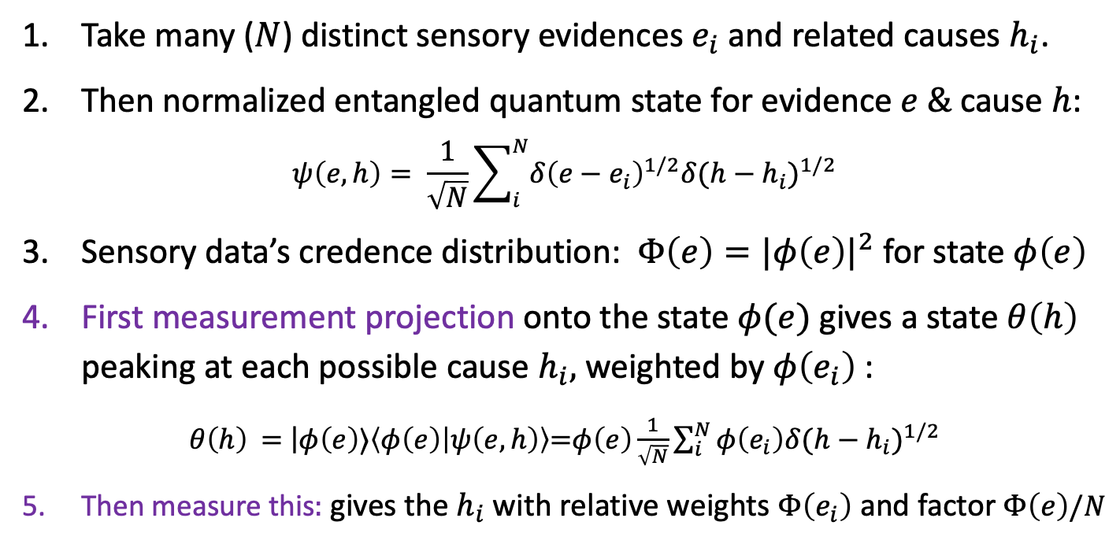

Quantum and sensory states can contain
Correlations and Entanglements
Take many ($N$) distinct sensory evidences $e_{i}$ and related causes $h_{i}$.
Then normalized entangled quantum state for evidence $e \&$cause $h$:
$$ψ\left(e,h\right)= \frac{1}{\sqrt{N}}\sum_{i}^{N}{{δ\left(e−e_{i}\right)}^{1/2}{δ(h−h_{i})}^{1/2}}$$
Sensory data’s credence distribution: ${Φ\left(e\right)=|φ\left(e\right)|}^{2}$ for state $φ\left(e\right)$
First measurement projection onto the state $φ(e)$ gives a state$θ\left(h\right)$ peaking at each possible cause $h_{i},$ weighted by $φ\left(e_{i}\right)$:
$θ\left(h\right)$ = $\left|φ\left(e\right)⟩\left\langle φ\left(e\right) | ψ\left(e,h\right)\right\rangle \right.$=$φ\left(e\right)\frac{1}{\sqrt{N}}\sum_{i}^{N}{φ\left(e_{i}\right){δ(h−h_{i})}^{1/2}}$
Then measure this$:$ gives the $h_{i}$ with relative weights $Φ\left(e_{i}\right)$ and factor$Φ\left(e\right)/N$
The factor $\frac{1}{N}$ gives the Probability Gap

Slide 11
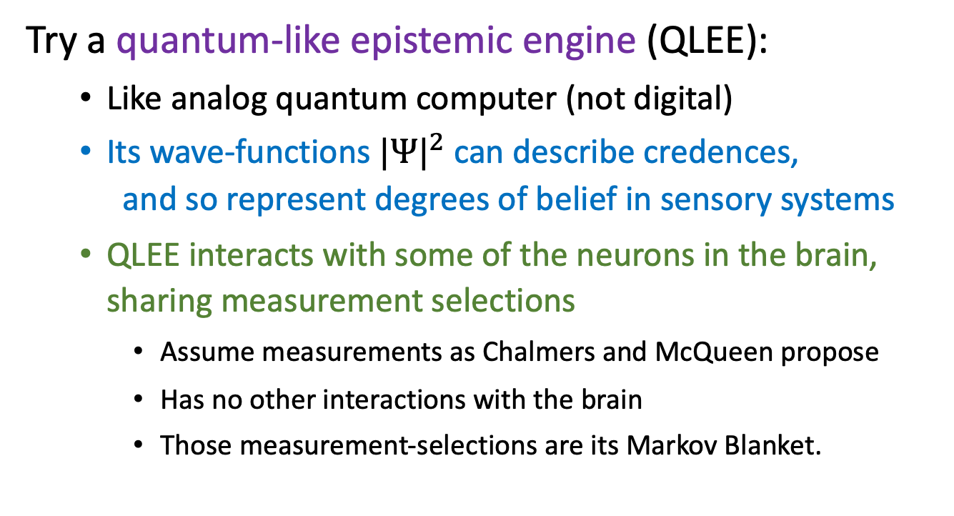
A Design proposal
Try a quantum-like epistemic engine (QLEE):
  Like analog quantum computer (not digital)
  Its wave-functions ${|Ψ|}^{2}$ can describe credences,
  and so represent degrees of belief in sensory systems
  QLEE interacts with some of the neurons in the brain, sharing measurement selections
    Assume measurements as Chalmers and McQueen propose
    Has no other interactions with the brain
    Those measurement-selections are its Markov Blanket.

Slide 12
Structure of the QLEE:
Quantum-like Epistemic Engine
Set up as we would an analog quantum computer:
Its initial quantum state: a very large number of stored correlations about objects in the world and their possible appearances
  each correlation state is an entangled set of object credences.
Further superpositions of spatial translations, rotations (etc) generate more sensory hypotheses
  implemented by Hamiltonian evolution of the system,
First joint measurement on QLEE determined by the sensory input
  Objects then observed using the sensory data input through the biological senses
Second measurement on QLEE gives credences for objects seen

Slide 13
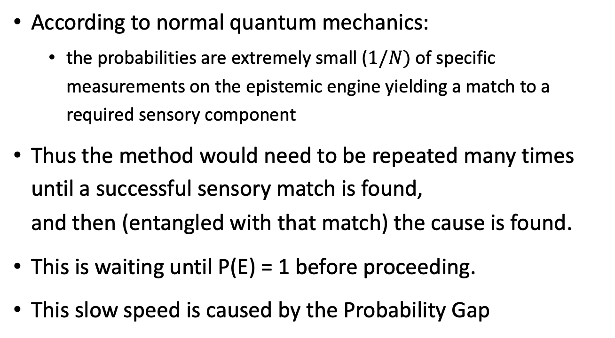
But this is Slow with
Standard Quantum Mechanics
According to normal quantum mechanics:
  the probabilities are extremely small ($1/N)$of specific measurements on the epistemic engine yielding a match to a required sensory component
Thus the method would need to be repeated many times until a successful sensory match is found,
and then (entangled with that match) the cause is found.
This is waiting until P(E) = 1 before proceeding.
This slow speed is caused by the Probability Gap

Slide 14
Speed up by some new physics:
I can speculate, since there is lack of knowledge concerning how measurement selection events actually occur.
So I formulate a theory that can be tested:
Specific joint measurement events exist with QLEE and neurons,
with outcome probabilites determined only by the neurons
via their own quantum processes. Senses determine sensations!
Not by both sides as in normal quantum theory.
New physics: call them Asymmetric Joint Measurement Events.
  This asymmetry is why I call it a quantum-like epistemic engine.
  This gives a one-step preparation of the QLEE state. Don’t wait for P(E)=1.
  Quick transmission of sensory information to the Epistemic Engine
  Bridges the Probability Gap, so sensory recognizing is not (much) random.

Slide 15
Theory Predictions to Test
Because the quantum-like proposal greatly changes the probabilities of events in the QLEE, and
the QLEE is used for sensory processing, then
the different probabilities should be easily tested by measuring speed and outcomes in sensory psychology.
Normally physicists do not change basic quantum probabilities, but not yet a fixed physical theory for quantum measurements, and here is something testable in experiments.

Slide 16
Where is this Quantum Engine?
Needs only ‘observation events’ to connect it to the brain
  No other neural sources of decoherence
  These same issues as for quantum computers
  Has to be thermally isolated.
Could be:
  Within microtubules within nerve cells?
  In a ‘bulk space’ predicted by high-dimensional string theory?
  In a new epistemic ‘mental’ space still to be discovered?
Let’s first propose, model and test this functionality.

Slide 17
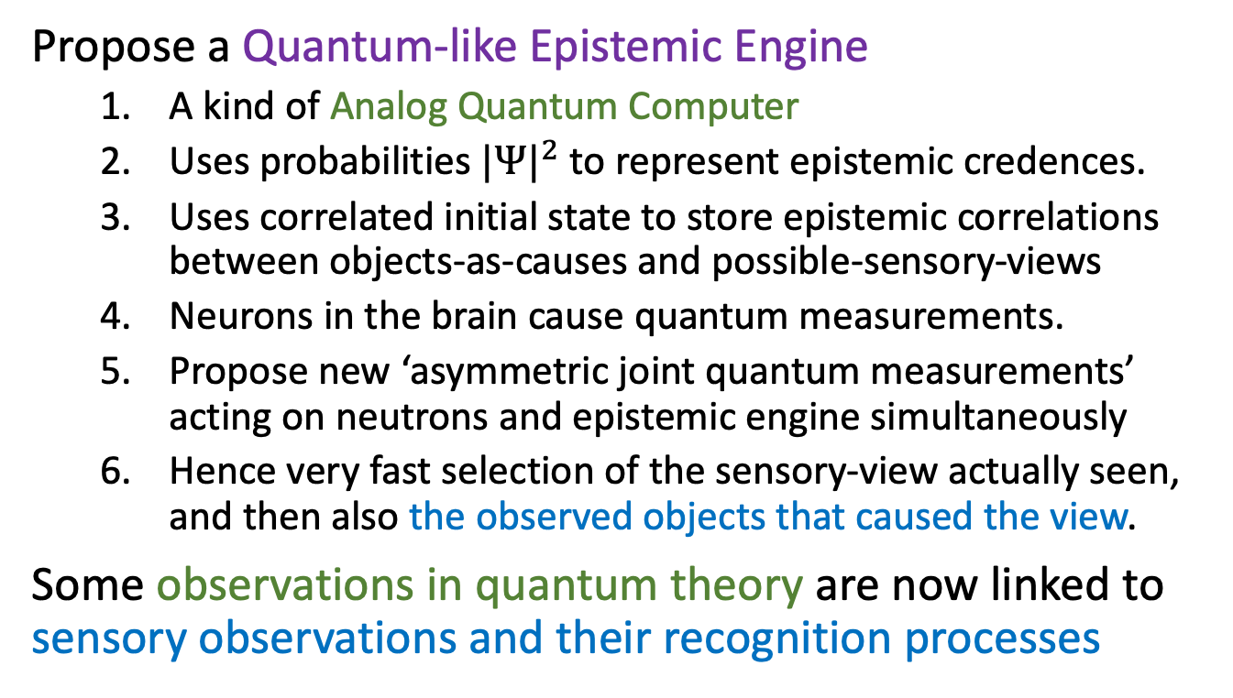
Summary
Propose a Quantum-like Epistemic Engine
  A kind of Analog Quantum Computer
  Uses probabilities ${|Ψ|}^{2}$ to represent epistemic credences.
  Uses correlated initial state to store epistemic correlations between objects-as-causes and possible-sensory-views
  Neurons in the brain cause quantum measurements.
  Propose new ‘asymmetric joint quantum measurements’
  acting on neutrons and epistemic engine simultaneously
  Hence very fast selection of the sensory-view actually seen,
  and then also the observed objects that caused the view.
Some observations in quantum theory are now linked to sensory observations and their recognition processes

Slide 18
Extra slides

Slide 19
Connecting Quantum Observations with Sensory Observations
The Quantum Bayes (QBist) approach:
Quantum Measurements are just following
the rules of Sensory Observation updating
New idea here is the opposite:
Sensory Observations are just following
the rules of Quantum Measurement updating
In fact:
Sensory Observations could be like Quantum Measurements

Slide 20
Connection with
Predictive Processing
Both Predictive Processing and method here produce
hypotheses in advance.
But updating hypotheses from sensorium is one-step
  Not iterative, but much faster.
  Not the usual Predictive Processing or Coding.
Still follows Bayesian update rules
  At least for commuting measurement observables: EH=HE
Friston was always envisaged building Bayesian rules into the primitive dynamics of the organism.

Slide 21
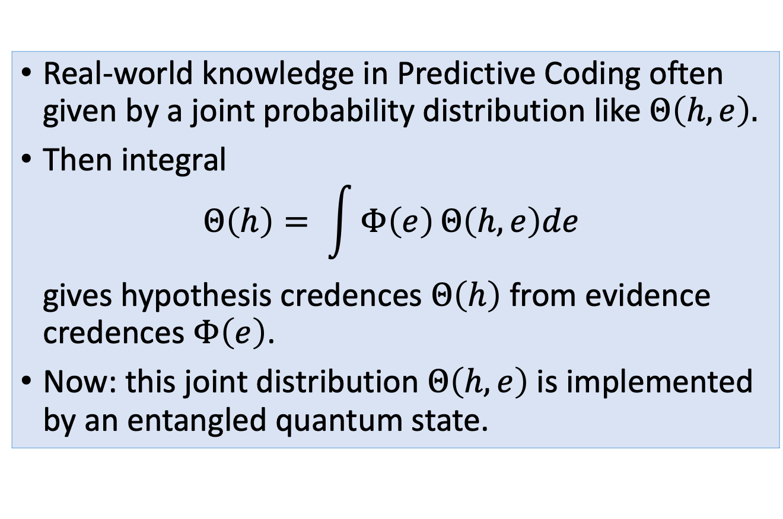
Joint Probabilities in
Predictive Processing theories
Real-world knowledge in Predictive Coding often given by a joint probability distribution like $Θ\left(h,e\right).$
Then integral
$Θ\left(h\right)= \int{Φ\left(e\right)}Θ\left(h,e\right)de$
gives hypothesis credences $Θ\left(h\right)$ from evidence credences $Φ\left(e\right)$.
Now: this joint distribution $Θ\left(h,e\right)$is implemented by an entangled quantum state.

