Slide 1
How the Non-Physical Influences
Physics and Physiology: a proposal
Ian Thompson Ph.D.
www.ianthompson.org
Livermore, California
(v7)

Slide 2
Outline of Talk
The Mind-Body problem and possible solutions
The Non-Physical
Finding a Soft Spot in quantum physics
Varying Electric Permittivity of the vacuum
Energy is not always conserved locally
‘Targets’ as a new level of physics for physiology
Numerical models of changing proteins
Summary

Slide 3
The Problem
Many talks at this SSE-PA convention provide evidence for novel causes and effects related to non-physical minds
We see effects in physical things.
Many effects of mind on our body every second.
Crossing the mind-body gap.
We ask:
Is something incomplete about physics?
Could experiments see specific new predictions?

Slide 4
Ways to cross mind-body gap
Monism (not really any gap):
  A combined physical + mental world has a uniform system of causes and effects
  What is mental is really physical & vice-versa. Strange.
Dualism (2 levels)
  There do exist distinct physical and mental substances.
  Separate but inter-connected in specific ways.
  No causal closure anywhere, but interactions
I base my theory Discrete Degrees (generalized dualism)
  From Emanuel Swedenborg: multi-level discrete degrees.

Slide 5
What is the Non-Physical?
Non-physical
Physical
Many discrete degrees or planes:
  Spiritual → Purposes → Mental → Intentions → Sensorimotor mind → Spiritual body → Final causes , Targets → Physical Changes
Here I focus on the last steps into the physical
  How the final causes could create targets which affects what happens in physics
  This can be applied to all kinds of spiritual and mental discrete degrees.
  So I take final causes & targets to be causally active
  Use non-physical and physical as different kinds of substances. We see how dualism can work.

Slide 6
Non-physical effects on Physical
Something is different in physics and physiology
because of non-physical input targets
  Should be effects in general cellular bio-chemistry
  Then also:
  we have effects of mental desires and intentions on neurons, leading to bodily movements
Try to keep existing structure of physical theory as much as possible
  Computers, microscopes, suns: all still work.
  Find a ‘soft spot’ in physical theory so laws are not always fixed, but vary as part of a bigger picture.

Slide 7
Physics in Living Systems
All living systems have bodies made of
protons, neutrons and electrons.
These made into atoms and molecules.
  In particular: very large protein molecules in cells
Many of these molecules have to fold into specific shapes to be catalysts or enzymes.
  The speed and directionality of folding is still a puzzle in biophysics (Levinthal’s Paradox since 1969)
  I predict:
  non-physical influences in living cells could provide targets for protein folding and so speed up folding.

Slide 8
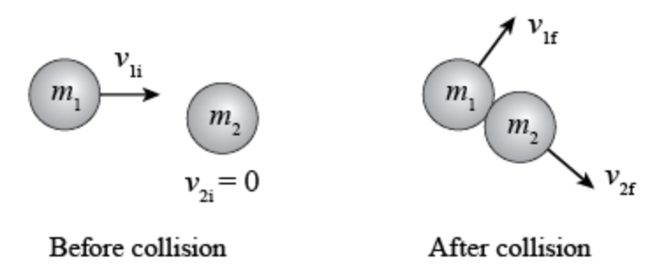
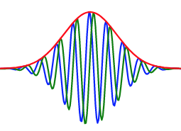
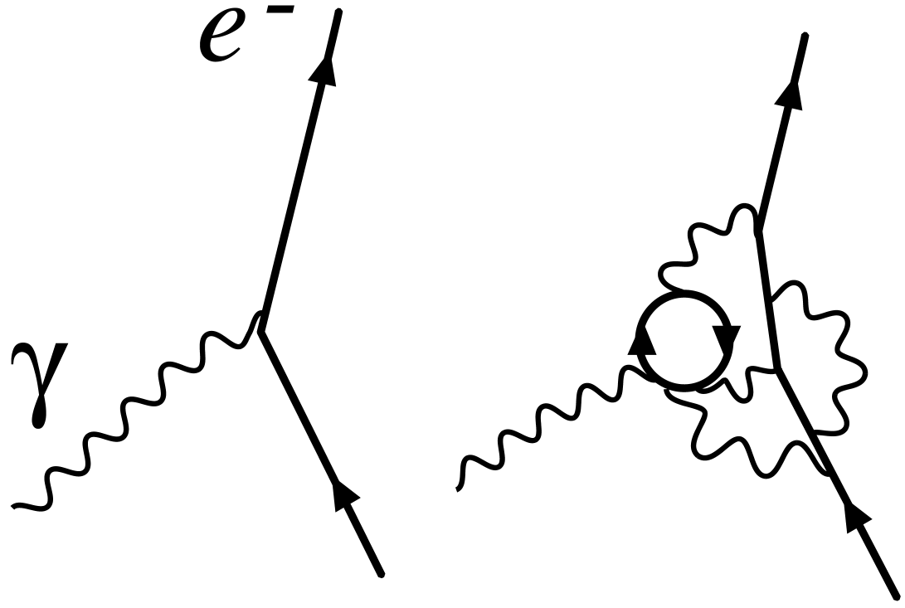
Discrete Degrees in Physics
- going from effects to causes, all connected
Classical Newtonian Physics
describes most large objects.
  Forces acting on masses giving acceleration
Quantum Mechanics is more accurate for
particles, atoms and molecules.
  Wave packets governed by Schrodinger Equation
The masses and forces in quantum mechanics determined by Quantum Field Theory
  Massive and massless fields governed by Field Lagrangians
What determines Lagrangian masses and charges?

Slide 9
Connecting outermost mental degree with innermost physical degree
Outermost
Non-physical
(sensorimotor)
New
Connection!
Lagrangian
Masses and Charges
Quantum
Fields
The sensorimotor mind is outer-most non-physical
The Lagrangian is the inner-most physical degree
This is where some connection should be expected!
(or a new degree between them)
Propose:
The non-physical influences the values of the Lagrangian masses and charges

Slide 10
Are Lagrangian coefficients fixed?
Many people think so.
  See ‘Parameters of the Standard Model’ in Wikipedia.
But these observed values are not the starting parameters.
RATHER:
  By a process called ‘renormalization’, the initial numbers are tuned to give the observed numbers as output.
But renormalization method is not fixed in theory.
  Method could be fine-tuned depending on place and time!
  Starting numbers could give varying masses and charges.

Slide 11
Have Charge Variations been seen?
Perhaps comparing with very distant stars:
John Webb et al, (2001, 2011):
  Measured variations in ratios of frequencies of spectral lines
  Found evidence that the electron charge q is very slightly smaller for distant stars (that is, in the past),
  by 1 part in 10^{5:}
So: variations are conceivable

Slide 12
Non-physical Effects on the Physical
Our idea:
the fine-tuned parameters (masses, charges) can be varied locally in order to achieve ends in nature.
We will focus on electric charges.
Physicists have proposed varying charges over the age of the universe.
Now we propose to vary it over micro-seconds,
and within living organisms.
A new idea.

Slide 13
Varying Electric Charge as a
Non-physical effect
A new discrete degree inside quantum field theory:
‘Targets’ received into the physics of physiological systems
  Final causes set targets (ends), to determine the ‘means’
  Reach targets by adjusting electric parameters of physical fields.
This is real fine-tuning,
  not gradually over whole universe (or fixing in the Big Bang),
  but differently at each time in each place in an organism
  “Local”, not “global” physics variations!
We suggest that this is specific to living organisms. That it occurs at all scales of psychology and biology: every day and every second of our lives.

Slide 14
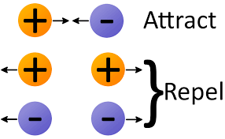
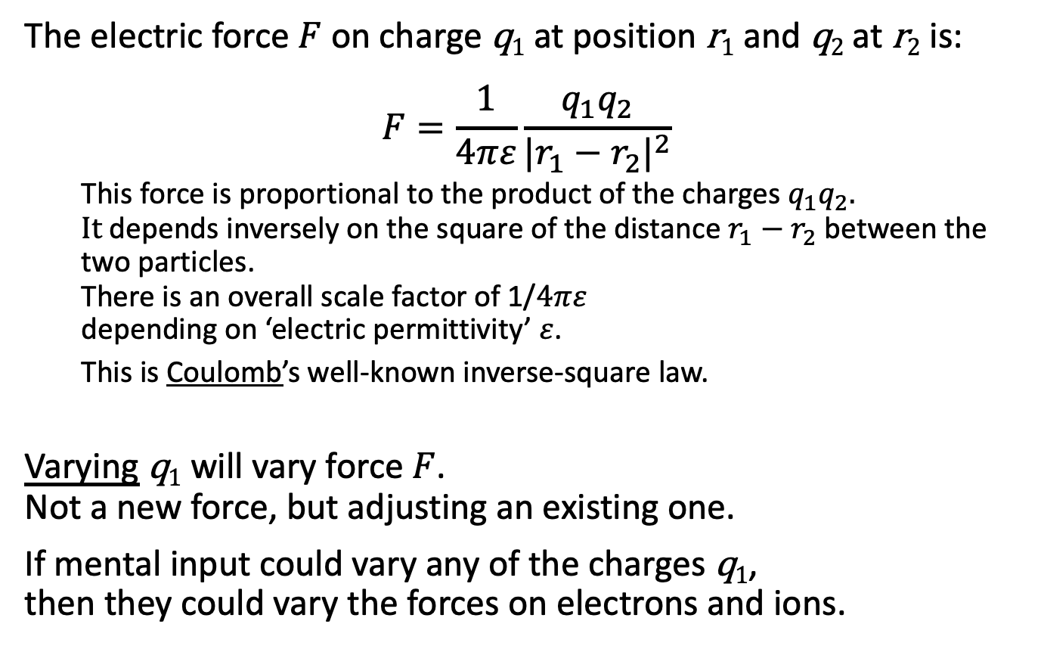
Electric Forces (inverse square law)
The electric force $F$on charge q₁ at position r₁ and q₂ at r₂ is:
$$F=\frac{1}{4πε}\frac{{q_{1}q}_{2}}{{|r_{1}−r_{2}|}^{2}}$$
  This force is proportional to the product of the charges ${q_{1}q}_{2}.$
  $It$ depends inversely on the square of the distance $r_{1}−r_{2}$ between the two particles.
  There is an overall scale factor of 1/$4πε$
  depending on ‘electric permittivity’ $ε$.
  This is Coulomb’s well-known inverse-square law.
Varying q₁ will vary force $F$.
Not a new force, but adjusting an existing one.
If mental input could vary any of the charges q₁,
then they could vary the forces on electrons and ions.

Slide 15
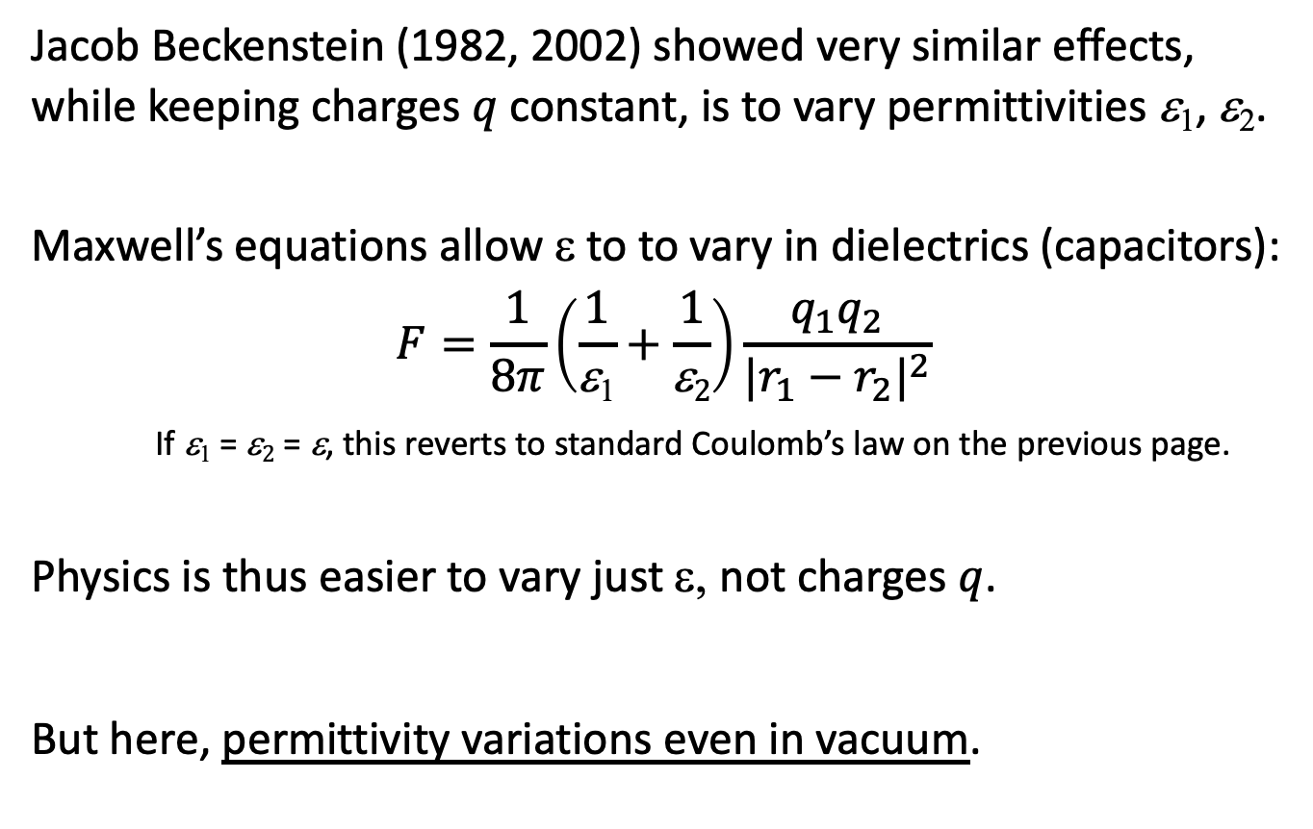
Electric Permittivity Varies
Jacob Beckenstein (1982, 2002) showed very similar effects, while keeping charges $q$constant, is to vary permittivities ε₁, ε₂.
Maxwell’s equations allow ε to to vary in dielectrics (capacitors):
$$F=\frac{1}{8π}\left(\frac{1}{\text{e}\text{1}}+\frac{1}{\text{e}2}\right)\frac{{q_{1}q}_{2}}{{|r_{1}−r_{2}|}^{2}}$$
If $\text{e}\text{1}$ = $\text{e}2$ = $\text{e}$, this reverts to standard Coulomb’s law on the previous page.
Physics is thus easier to vary just ε, not charges $q$.
But here, permittivity variations even in vacuum.

Slide 16
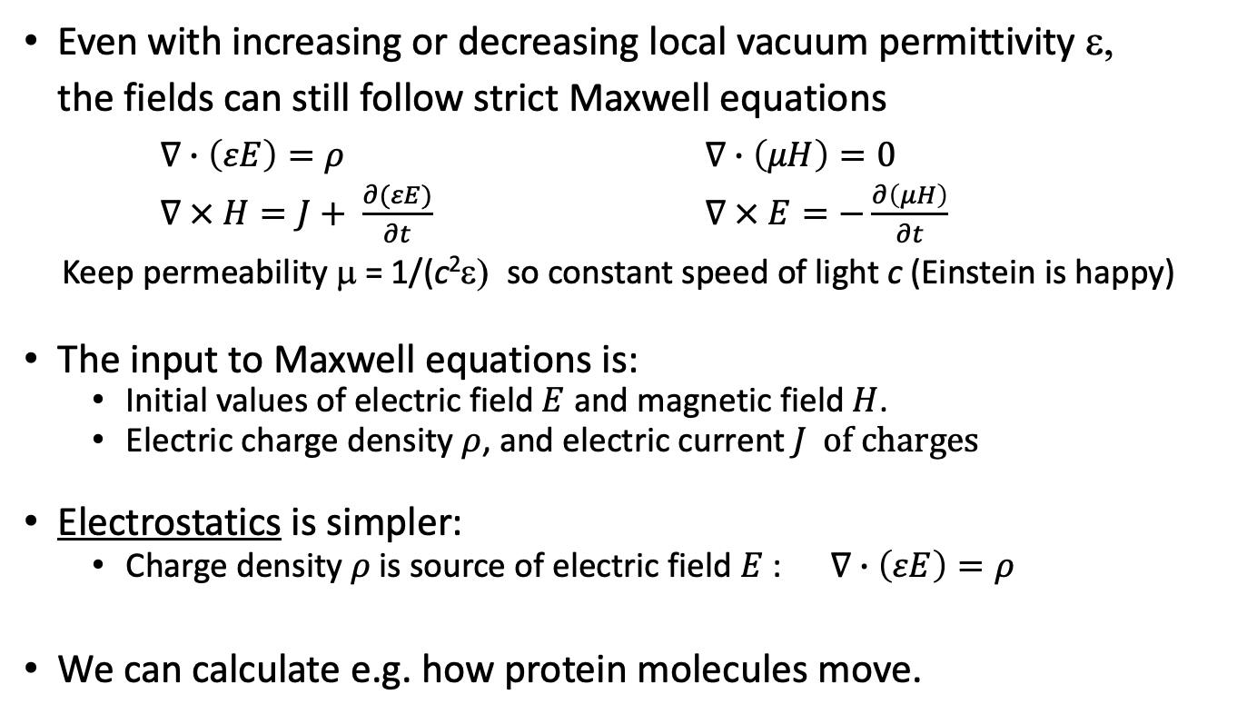
Electromagnetic fields
Even with increasing or decreasing local vacuum permittivity ε,
the fields can still follow strict Maxwell equations
$∇∙\left(εE\right)=ρ$ $∇∙\left(μH\right)=0$
$∇ × H=J+ \frac{∂(εE)}{∂t}$ $∇ × E=−\frac{∂\left(μH\right)}{∂t}$
Keep permeability μ = 1/(c²ε) so constant speed of light c (Einstein is happy)
The input to Maxwell equations is:
  Initial values of electric field $E$ and magnetic field $H$.
  Electric charge density $ρ$, and electric current $J of charges$
Electrostatics is simpler:
  Charge density $ρ$is source of electric field $E$ : $∇∙\left(εE\right)=ρ$
We can calculate e.g. how protein molecules move.

Slide 17
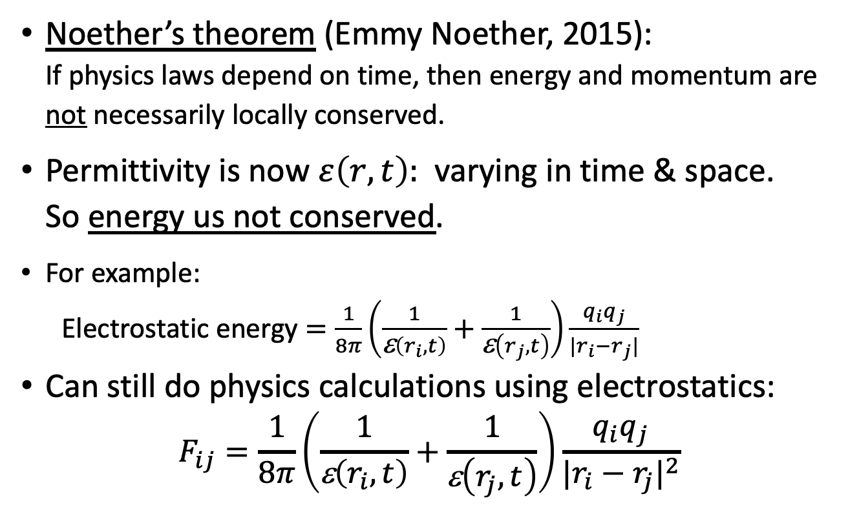
Energy is not always conserved
Noether’s theorem (Emmy Noether, 2015):
If physics laws depend on time, then energy and momentum are not necessarily locally conserved.
Permittivity is now $ε\left(r,t\right):$ varying in time & space.
So energy us not conserved.
For example:
Electrostatic energy $=\frac{1}{8π}\left(\frac{1}{\text{e}\left(r_{i},t\right)}+\frac{1}{\text{e}\left(r_{j},t\right)}\right)\frac{{q_{i}q}_{j}}{|r_{i}−r_{j}|}$
Can still do physics calculations using electrostatics:
$$F_{ij}=\frac{1}{8π}\left(\frac{1}{\text{e}\left(r_{i},t\right)}+\frac{1}{\text{e}\left(r_{j},t\right)}\right)\frac{{q_{i}q}_{j}}{{|r_{i}−r_{j}|}^{2}}$$

Slide 18
Other schemes trying to keep Conservation of Energy
Physics extensions have been proposed which keep
  Energy conservation and
  Causal closure of the physical.
For example:
  Biased probabilities in quantum mechanics (John Eccles)
  Varying time of probabilistic events (Henry Stapp)
  Moving energy from one location to a nearby place
  But does not conserve energy locally.
  Non-local entanglement (Amit Goswami)
  But cannot be used for signals.
Remember: changes in quantum chances are very small!
Electric changes are bigger.

Slide 19
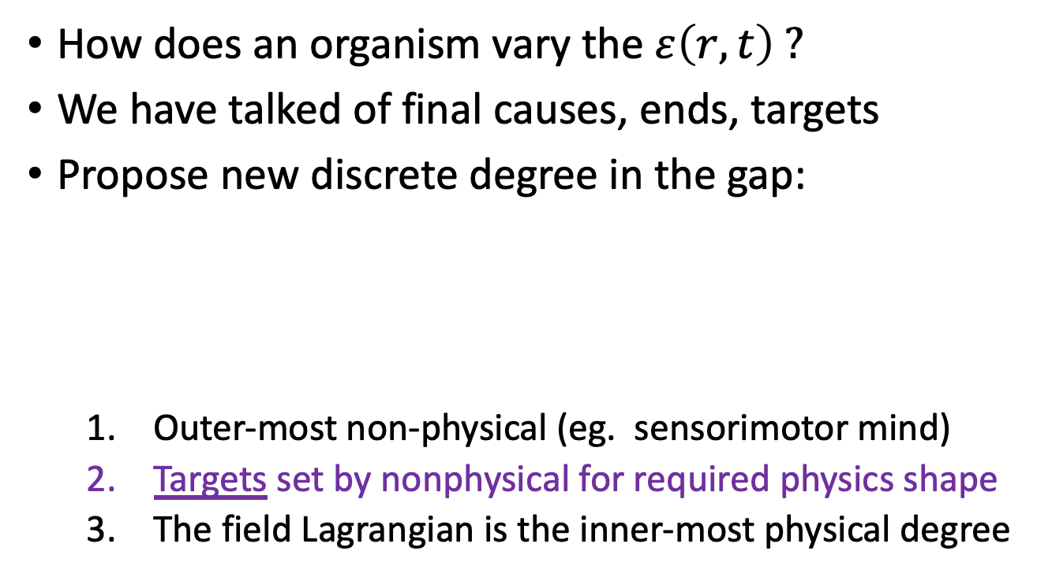

Achieving useful ends: Targets.
How does an organism vary the $ε\left(r,t\right) ?$
We have talked of final causes, ends, targets
Propose new discrete degree in the gap:
  Outer-most non-physical (eg. sensorimotor mind)
  Targets set by nonphysical for required physics shape
  The field Lagrangian is the inner-most physical degree
Outermost
Non-physical
(sensorimotor)
Targets
Lagrangian
Masses and Charges
Final
causes
Varys
$$ε\left(r,t\right)$$
Quantum
Fields

Slide 20
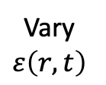
Achieving Targets in New Physics
Michael Levin (2012): cells need feedback system to
  1) know the shape S it is supposed to achieve (target),
  2) tell if its current shape S₀ differs from this target,
  3) compute means-ends analysis to get from S₀ to S,
  4) perform a kind of self-surveillance to know when the desired shape has been reached.
Need extra step:
Difference (current–target)
Outermost
Non-physical
(sensorimotor)
Targets
Lagrangian
Masses and Charges
Final
causes
Vary
$$ε\left(r,t\right)$$
Quantum
Fields

Slide 21
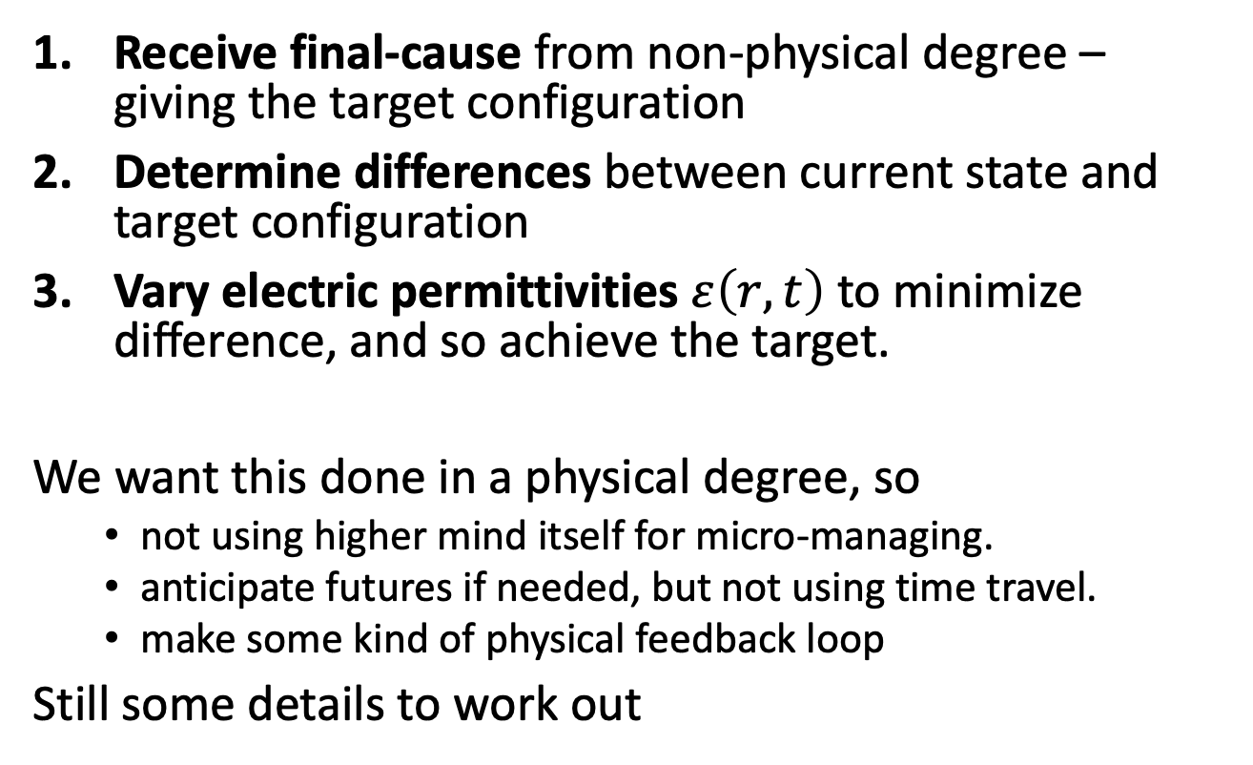
Three Function of Targets
Receive final-cause from non-physical degree – giving the target configuration
Determine differences between current state and target configuration
Vary electric permittivities $ε\left(r,t\right)$ to minimize difference, and so achieve the target.
We want this done in a physical degree, so
  not using higher mind itself for micro-managing.
  anticipate futures if needed, but not using time travel.
  make some kind of physical feedback loop
Still some details to work out

Slide 22
Anticipating future configurations?
Targeting would be more effective if it could anticipate physical configurations in near future
  Needed, say, for a flying bird to intercept an insect.
  Target now specified as some future target-time.
Then adjust permittivities in whole time interval from now until the target-time.
This can be done in physics if we separate
‘metric time’ from ‘process time’.

Slide 23
Metric time and Process time
Since Henri Bergson, A.N. Whitehead, and quantum mechanics,
we expect 2 kinds of time:
  Metric time (clock time) : measurable time like space (i.e. spacetime)
  Process time of changes of state (successive actualizations of propensities, such as in quantum selections)
We are going to use both kinds of time.
  To extrapolate present causes into effects in the near future of spacetime, as metric future exists now already.
  Thus allow a targeting system to measure
  the current-extrapolation difference to its target.

Slide 24
Adjusting Future Permittivities
Use forward-propagated waves in metric time.
  So extrapolation—target difference found at the target-time.
Back-propagate adjoint waves in metric time
  Time-reversed solution of Maxwell equations (for e/m waves) and of Newton equations (for particles) from target-time back to present.
These adjoint waves give the sensitivities
needed to vary the permittivities in between to
reduce the extrapolation—target difference.
Repeat at intermediate process times,
so the physical system reaches the target in reality.

Slide 25
Numerical Examples of Targets for Proteins,
Using Molecular Dynamics models
Forward- and back-propagation to reach Targets by Varying Charges
Numerical Demonstration

Slide 26
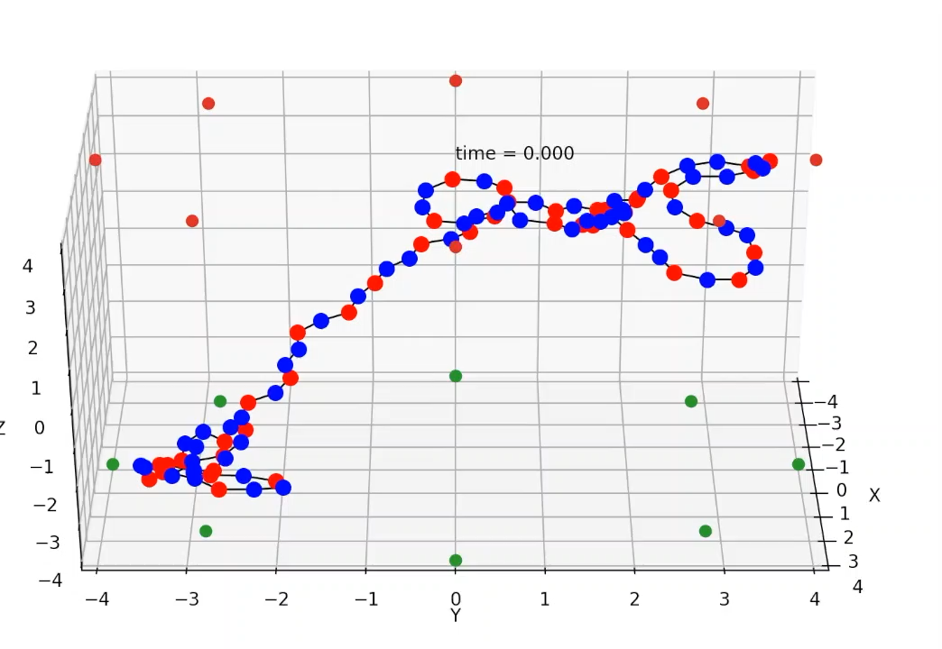
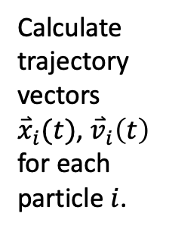
Demonstration using 100 particles inside a cage of 2 rings, 16 charges
A molecule
put in a
cage.
Calculate
trajectory
vectors
${\overset{⃑}{x}}_{i}(t)$, ${\overset{⃑}{v}}_{i}\left(t\right)$
for each
particle $i$.
Units
Time:
ps = 10⁻¹² s
Space:
nm = 10⁻⁹ m
Blue: +0.2e charge. Red: -0.2e charge (e=unit charge).
Cage charges are -3e, like GroEL chaperone molecule
Bond lengths and angles specified.
Repulsive cage wall. No water

Slide 27
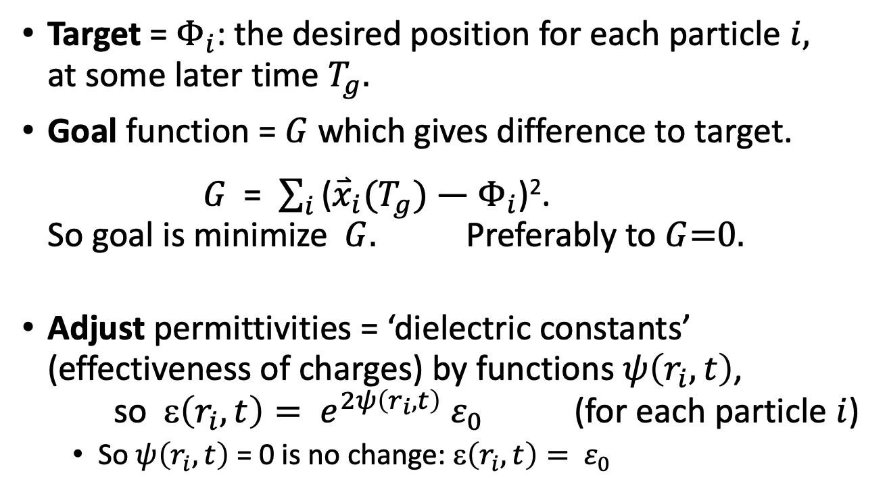
Targets and Adjustments
Target = $Φ_{i}$: the desired position for each particle $i,$
at some later time $T_{g}.$
Goal function = $G$ which gives difference to target.
$G$ = $\sum_{i}{\text{(}{\overset{⃑}{x}}_{i}(T_{g})\text{ — }Φ_{i}\text{)}\text{2}}$.
So goal is minimize$G$. Preferably to $G$=0.
Adjust permittivities = ‘dielectric constants’ (effectiveness of charges) by functions $ψ\left(r_{i},t\right)$,
so ε$\left(r_{i},t\right)= e^{2ψ\left(r_{i},t\right)}{ ε}_{0}$ (for each particle $i$)
  So $ψ\left(r_{i},t\right)$ = 0 is no change: ε$\left(r_{i},t\right)= { ε}_{0}$
Done with 3700 lines of Python, with Cython to compile C kernels.

Slide 28
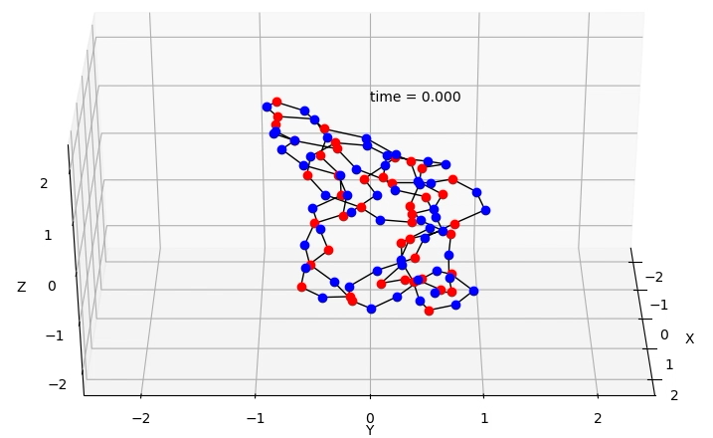
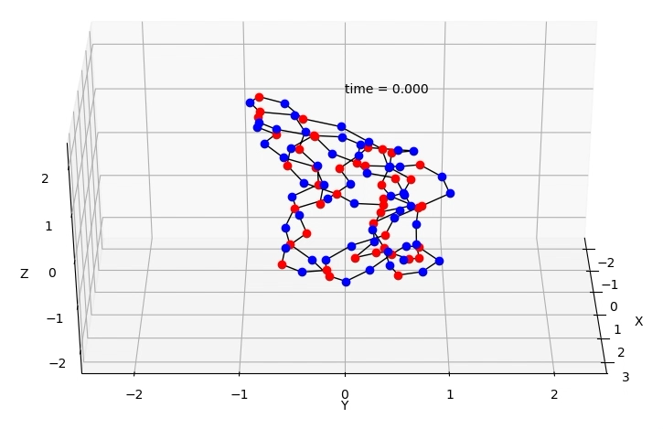
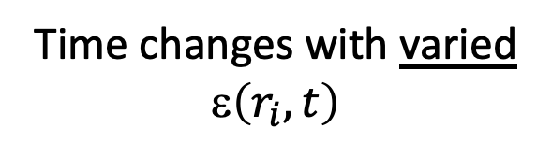
Demonstration 1:
Shifting centroid to the left by 1 nm
Time changes with varied ε$\left(r_{i},t\right)$
Normal time changes

Slide 29
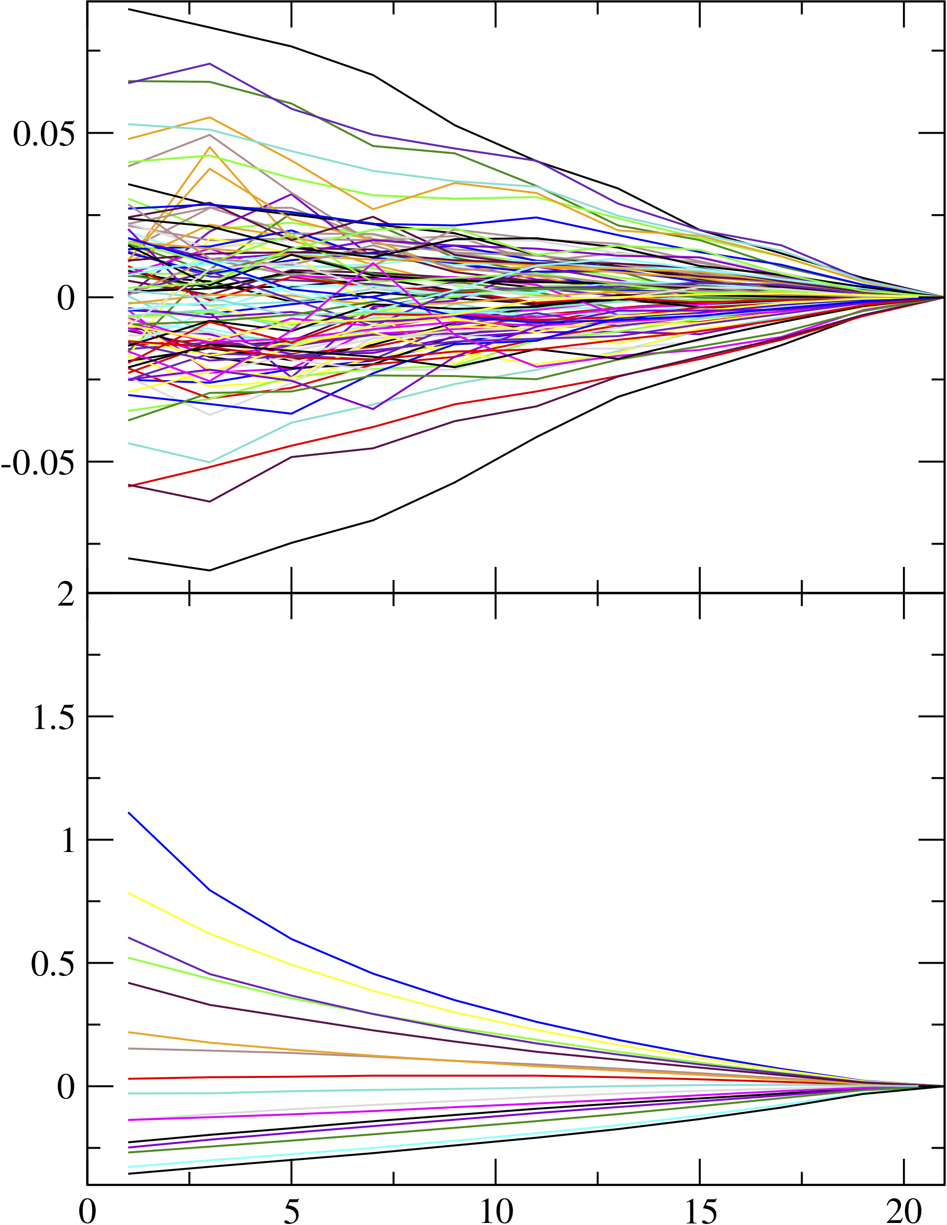
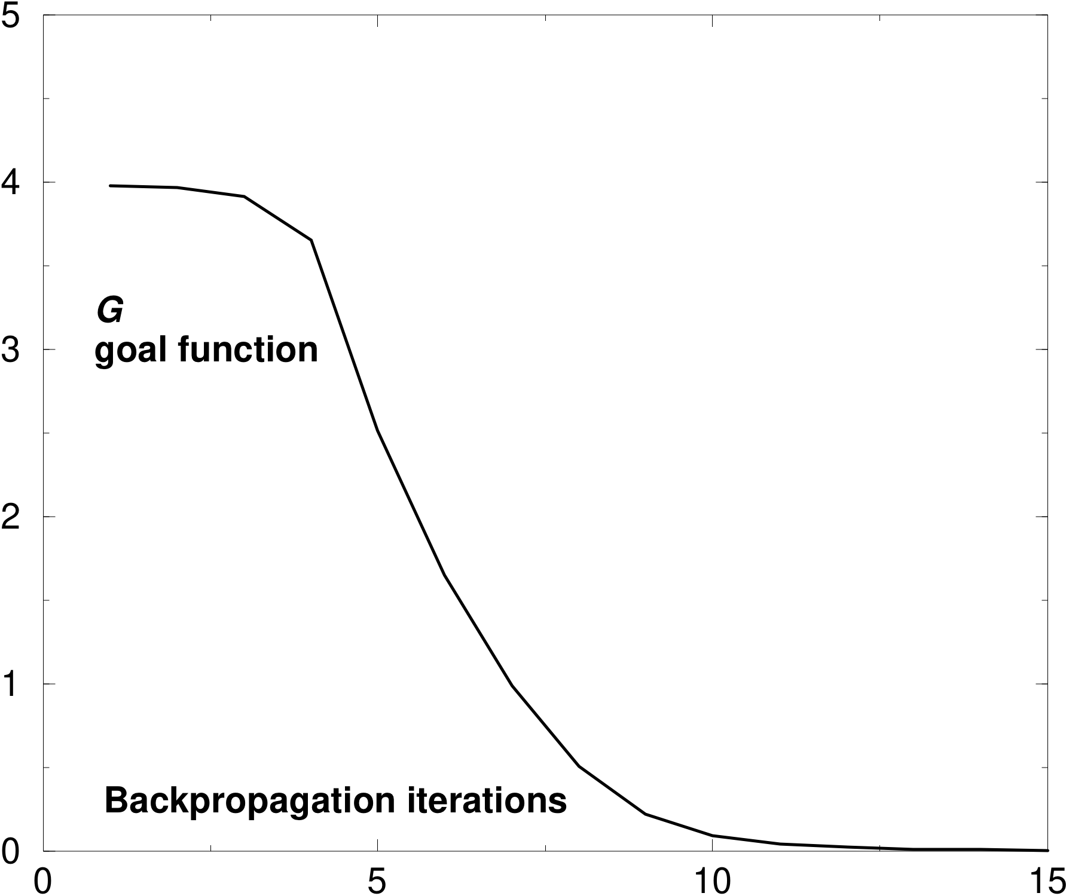
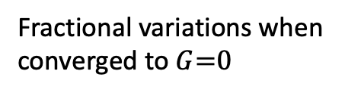
Demonstration 1: Shifting left.
Fractional variations when
converged to $G$=0
Difference extrapolation—target,
with repetitions of forward-back propagations:
Variation in molecule charges
Variation in cage charges
A few have large increases

Slide 30
Experimental Test of Predictions
General predictions:
  Physical processes proceed more quickly to useful result.
  This happens particularly with charged particles/atoms.
Specific predictions:
  Electric effects in living organisms fluctuate for targets
  Vacuum Permittivity changes in atoms and in cells
    Must distinguish from solvent permittivity changes
  This model only changes the physics parameters needed to get useful results – probably not all surrounding region.
    So must measure energy level changes in atoms in causal chain
    Atoms have brief shifts in energies and fluorescent light

Slide 31
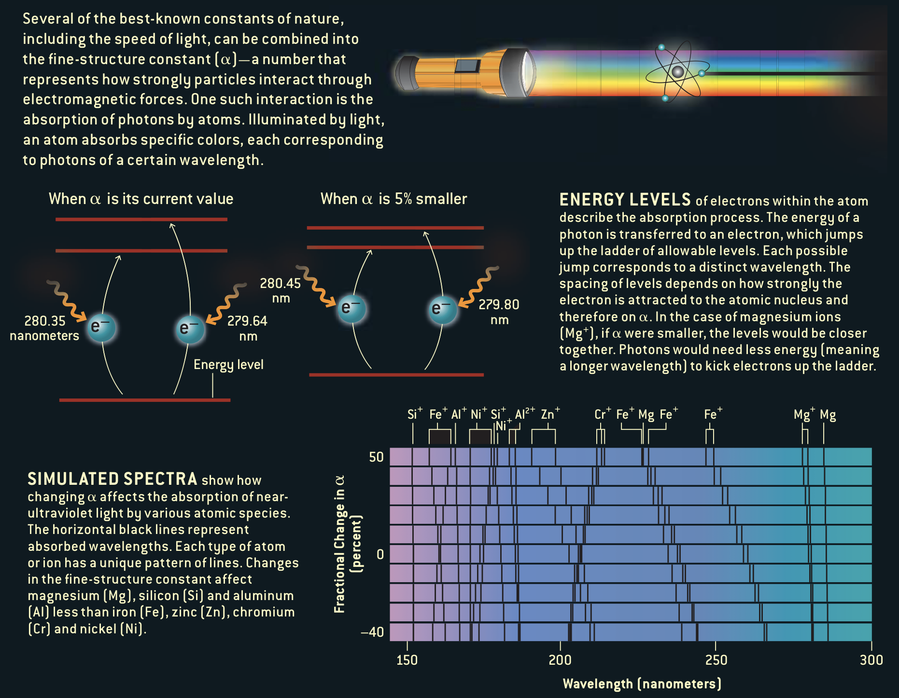
Measuring fluorescence spectra
from:
John Barrow &
John Webb,
Scientific
American
(2005) 56-63.

Slide 32
Summary of overall answers:
We can propose two hypotheses to answer the questions:
WHAT do mental (etc.) effects change in physics?
Answer: The relative permittivity of the vacuum
HOW these changes could be used in physiology?
Answer: For target configurations given by input from the non-physical into cells, there is a physical feedback mechanism to bring physical objects closer to this target in the near future.

Slide 33
Implications
How non-physical things could have effects in nature.
These effects on permittivity should be measurable
Final causes and targets would be active in nature.
  We have a way to bring the future into line,
  without time travel.
Widens the field of scientific explanations concerning mental and other non-physical causes.
No longer is the physical universe causally closed.

Slide 34
References
Webb, J.K. (2001), M T Murphy, V V Flambaum, V A Dzuba, J D Barrow, C W Churchill, J X Prochaska, and A M Wolfe, Further Evidence for Cosmological Evolution of the Fine Structure Constant, Phys Rev Lett, 87, 205-4.
Webb, J. K. (2011), King, J. A., Murphy, M. T. and Flambaum, V. V. and Carswell, R. F. and Bainbridge, M. B., Indications of a Spatial Variation of the Fine Structure Constant, Phys. Rev. Lett. 107, 191101.
Bekenstein, J.D. (1982). Fine Structure Constant: Is It Really a Constant? Phys Rev, D25, 1527.
Bekenstein, J.D. (2002) Fine-structure constant variability, equivalence principle, and cosmology. Phys Rev D, 66, 884.
Levin, M. (2012) Morphogenetic fields in embryogenesis, regeneration, and cancer: Non-local control of complex patterning, Biosystems, 109, 243
This is a ‘backpropagation method’ common in computer modeling https://en.wikipedia.org/wiki/Backpropagation .
Adjoint solutions are often used in design problems in engineering, to find the sensitivities to all input parameters of an overall performance measure. https://en.wikipedia.org/wiki/Adjoint_state_method

Slide 35
THE END

